Slide 1
Neural circuits for olfactory chemotaxis
Nikhil Bhatla
January 14, 2013
MIT IAP

Slide 2
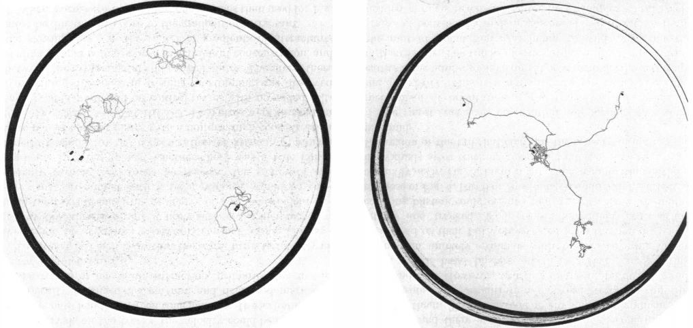
C. elegans move to the peak of a chemical gradient (chemotaxis)
3 worms explore without
chemical gradient
3 worms explore with
chemical gradient (peak at center)
15 min tracks
Attracting is chloride ions
Ward 1973

Slide 3
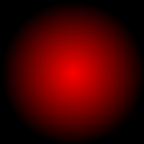
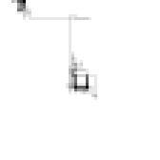
Directed movement by klinokinesis
(aka ‘biased random walk’)
START
Attractant gradient
Simulated bacterium’s path
Simulation result from Bacterial Chemotaxis Simulator: wormweb.org/bacteriachemo

Slide 4
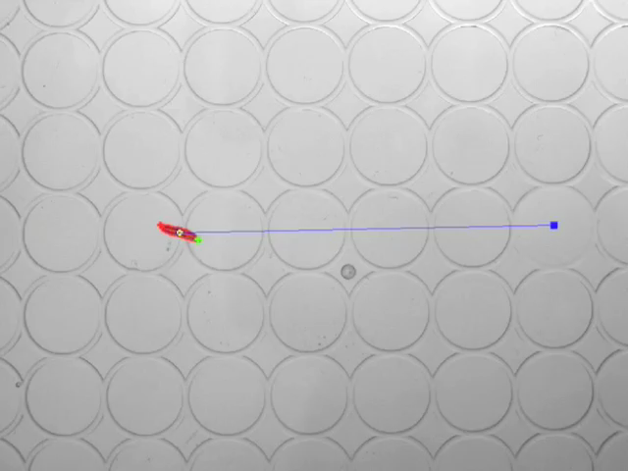
Directed movement by klinotaxis
(aka ‘weathervane’)
Drosophila larvae
Gomez-Marin..Louis 2011

Slide 5
C. elegans move to the peak of a chemical gradient (chemotaxis)
3 worms explore without
chemical gradient
3 worms explore with
chemical gradient (peak at center)
15 min tracks
Attracting is chloride ions
Ward 1973

Slide 6
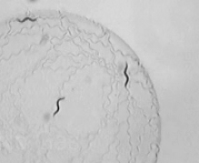
C. elegans locomotion patterns
Cheung..de Bono 2005

Slide 7
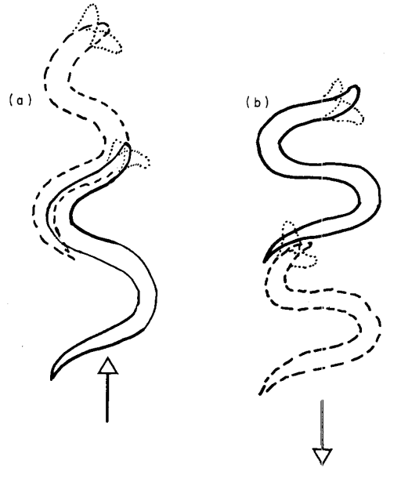
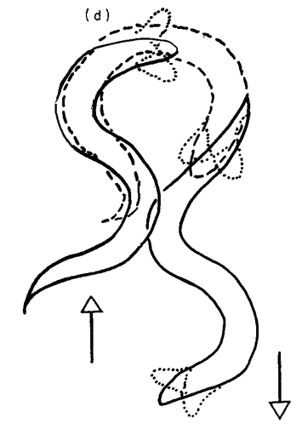
C. elegans locomotion patterns
forward
backward
omega turn
Croll 1975

Slide 8
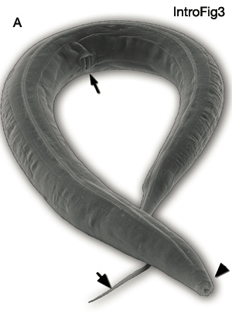
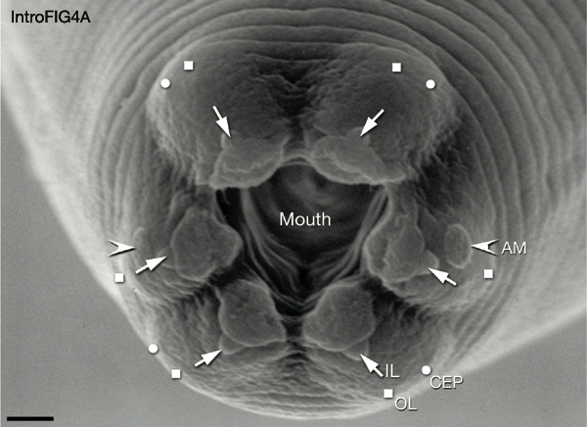
Head Sensilla
AM = amphid (12 neurons x 2)
IL = inner labia (2 neurons x 6)
OL = outer labia (1 neuron x 6)
CEP = cephalic (1 neuron x 4)
WormAtlas.org

Slide 9
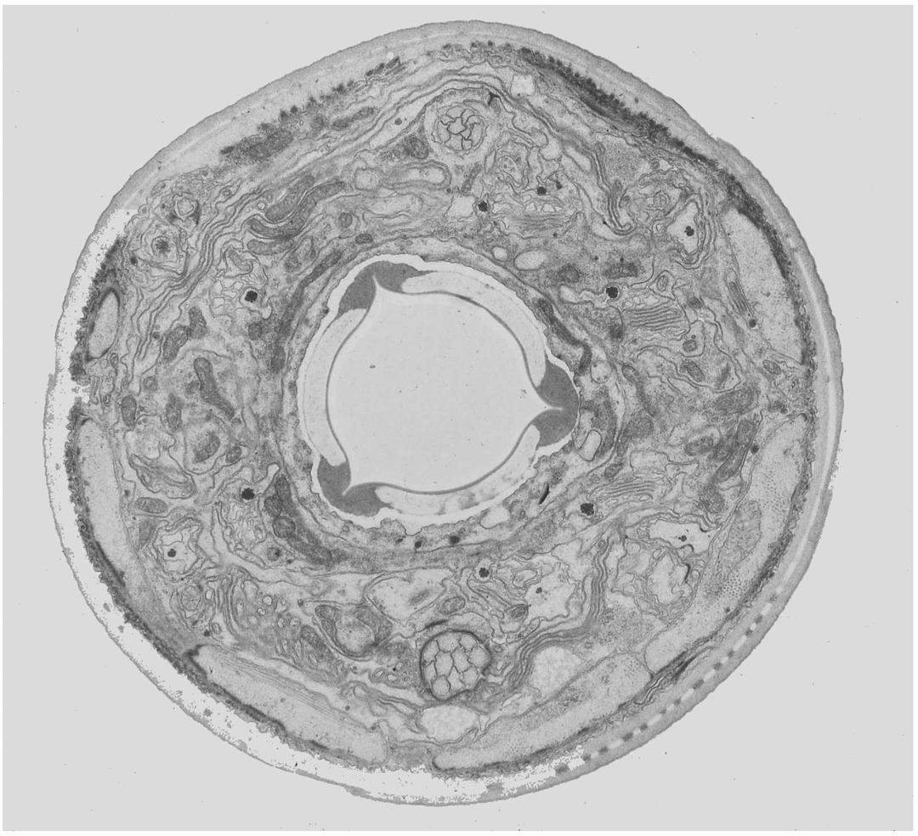
Amphids
Cross section at tip of nose
WormAtlas.org

Slide 10
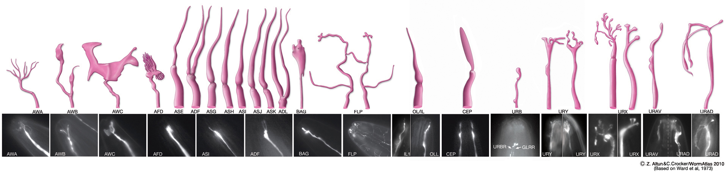
Head sensory neuron cilia
Senses:
attractive
odorants
repulsive
odorants
attractive
odorants
temp.
pheromones
salt
O₂ & CO₂
harsh touch
nose touch
Senses:
nose touch
food shape?
?
mating cue?
O₂
?
?
WormAtlas.org

Slide 11
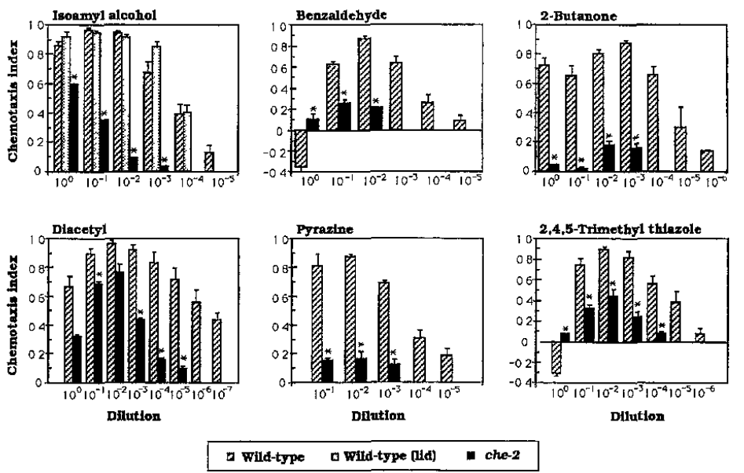
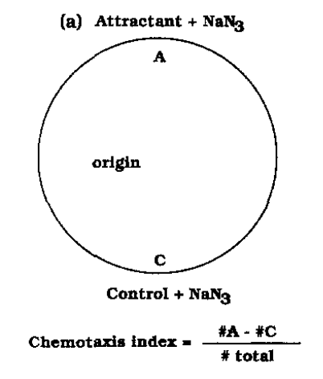
Worms are attracted to various odorants
che-2 is required for cilia formation
Bargmann..Horvitz 1993

Slide 12
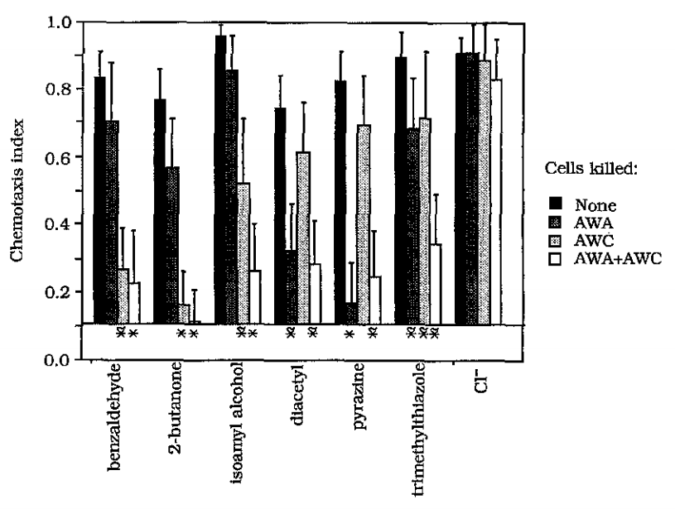
AWA and AWC are involved in sensing mostly different odorants
Bargmann..Horvitz 1993

Slide 13
Sensors for chemoattractants
diacetyl
pyrazine
AWA
chemotaxis
trimethylthiazole
butanone
AWC
chemotaxis
benzalehyde
isoamyl alcohol
Derived from Bargmann..Horvitz 1993

Slide 14
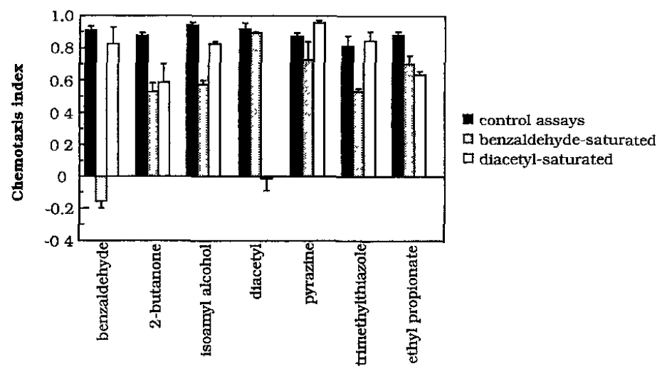
Worms can distinguish odorants smelled by the same sensory neuron
Bargmann..Horvitz 1993

Slide 15
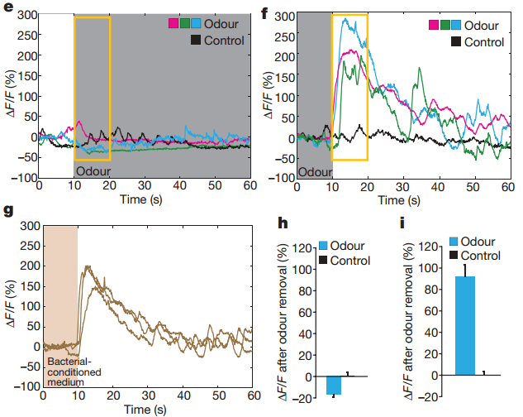
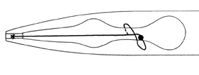
AWC responds most strongly to
IA and food removal
AWC
Chalasani..Bargmann 2007

Slide 16
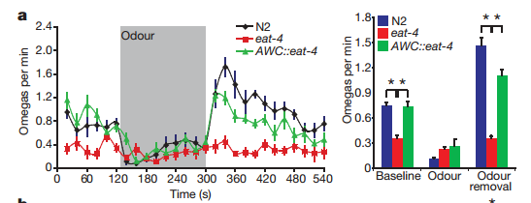
AWC activity correlates with omega turns
Chalasani..Bargmann 2007

Slide 17
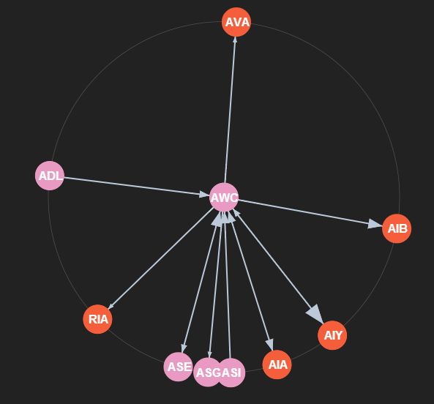
AWC primarily outputs to AIY, AIB and AIA
WormWeb.org/neuralnet

Slide 18
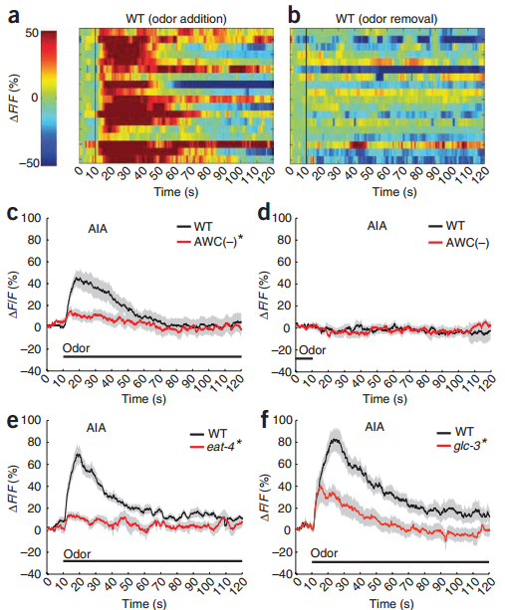
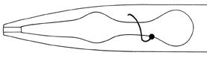
AWC inhibits AIA via glc-3
AIA
Chalasani..Bargmann 2010

Slide 19
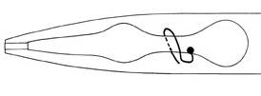
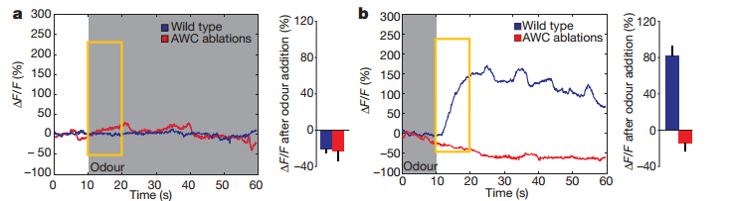
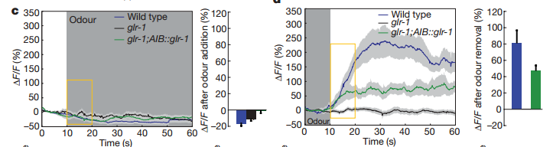
AWC activates AIB via glr-1
AIB
Chalasani..Bargmann 2007

Slide 20
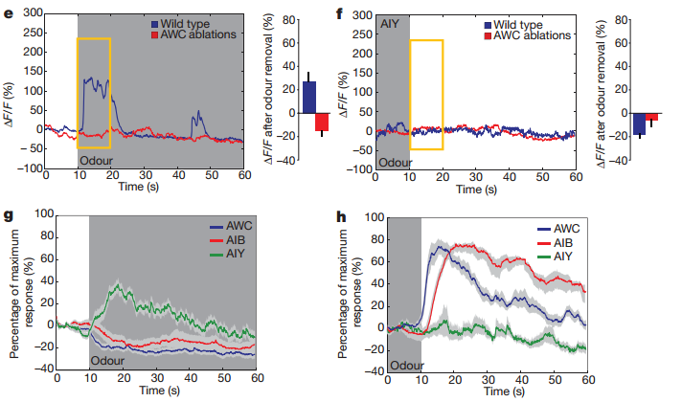
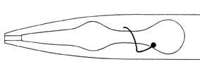
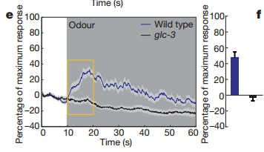
AWC inhibits AIY via glc-3
AIY
Chalasani..Bargmann 2007

Slide 21
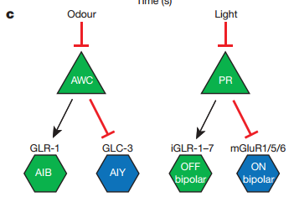
Similar to sensory processing in the retina?
photoreceptor
rods
Chalasani..Bargmann 2007

Slide 22
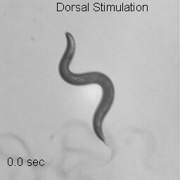
Worm nose wiggles control turning in response to odors
dorsal
Kocabas..Ramanathan 2012

Slide 23
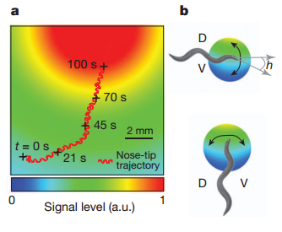
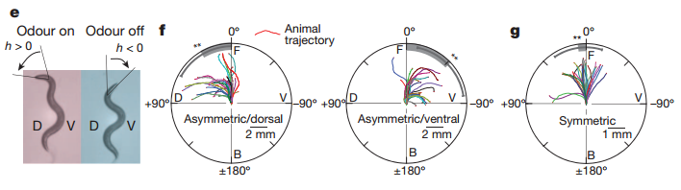
Worm turns in direction of odor
bacteria
Kocabas..Ramanathan 2012

Slide 24
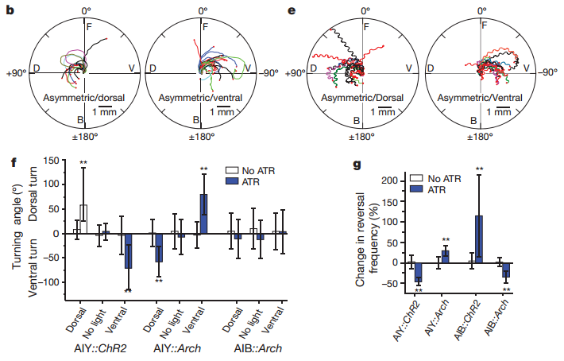
Activation of AIY during nose bending controls turning and reversals
worm centroid
worm nose
symmetric
stimulation
Kocabas..Ramanathan 2012

Slide 25
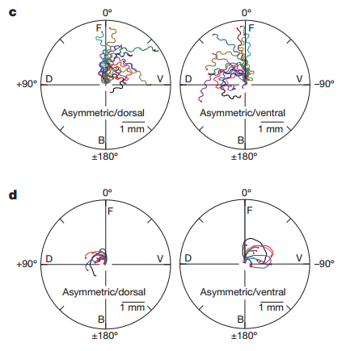
SMB activation causes turning in the nose direction, while RME activation causes turning in the opposite direction
AIZ:
SMB:
Kocabas..Ramanathan 2012

Slide 26
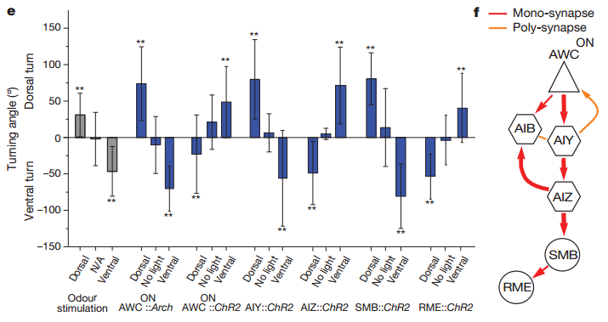
Activation of AIY & SMB and inhibition of AWC & AIZ & RME controls turning
Kocabas..Ramanathan 2012

Slide 27
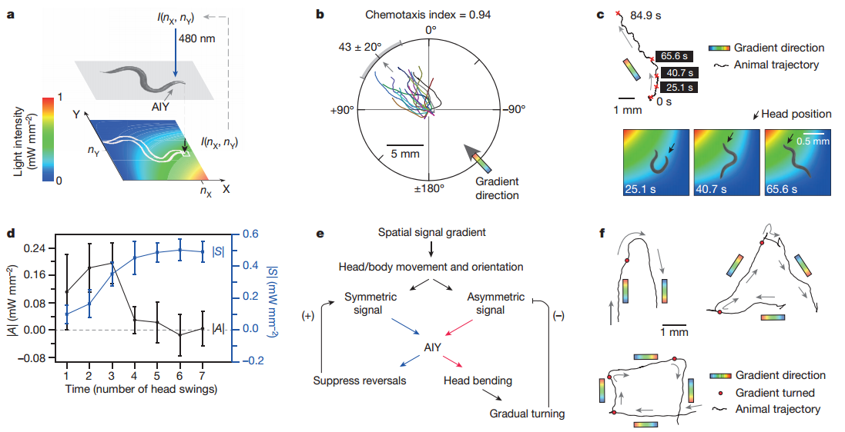
Light intensity-varying stimulation of AIY results in virtual chemotaxis
Kocabas..Ramanathan 2012

Slide 28
Odorant chemotaxis circuit
AIY
GLC-3
AIZ
SMB
RME
GABA?
ACh?
nose muscle
isoamyl alcohol
Glu
AIA
AWC
Glu
GLC-3
Glu
turn toward
isoamyl alcohol
isoamyl alcohol
removal
AIB
chemotaxis
GLR-1
Derived from Bargmann..Horvitz 1993, Chalasani..Bargmann 2007, Kocabas..Ramanathan 2012

